Slide 1
Brian Vineyard
Data Analyst Portfolio

Slide 2
Skills and Experience
Data Cleaning and Transformation
Load data from: Live SQL DB connections, Text Files, PDF, Web
Clean data: Remove duplicates, look for missing/invalid values
Transform data using Power Query to set data types, modify columns/values
Model Data
Set up relational DB tables with primary / foreign keys
Design pivot tables and DAX formulas to model data based on Key Performance Indicators (KPI)
Optimize queries for performance and processing large datasets
Reports and Dashboards
Build clean dashboards and reports that use best practices to convey key points
Collaborate with Stakeholders and Continuously Improve Reports
Regular cadence of updates to meet current needs and ensure best end-user experience
Presentation and Technical Writing
Skilled at presenting results in formal presentations to entire company + board
Technical documentation, help files, and knowledgebase content

Slide 3
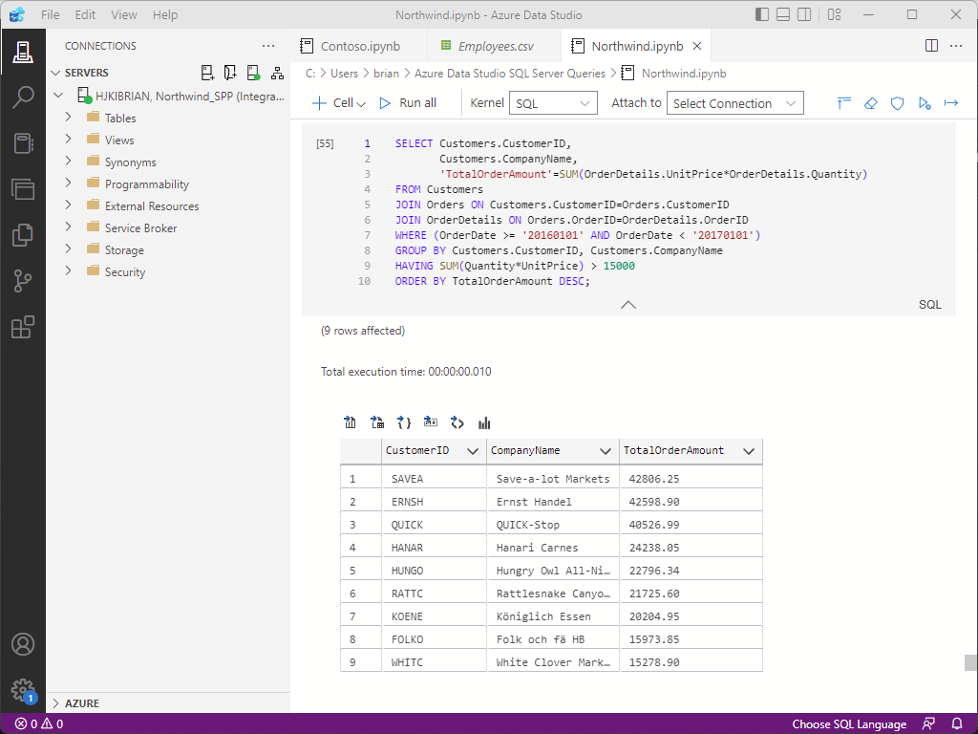
SQL: SQL Server, SSMS, Azure Data Studio
This query is in an Azure Data Studio notebook connected to the Northwind database in SQL Server.
This returns the CustomerID,
CompanyName and TotalOrderAmount
for orders with totals greater than $15,000
in 2016.
Results can be saved as a .CSV file, or
produced as visual charts.
Azure Data Studio is a free tool and with
Python and Jupyter Notebooks are a great way to do analysis at low cost.

Slide 4
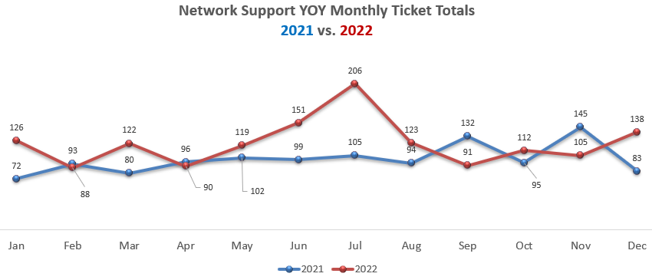
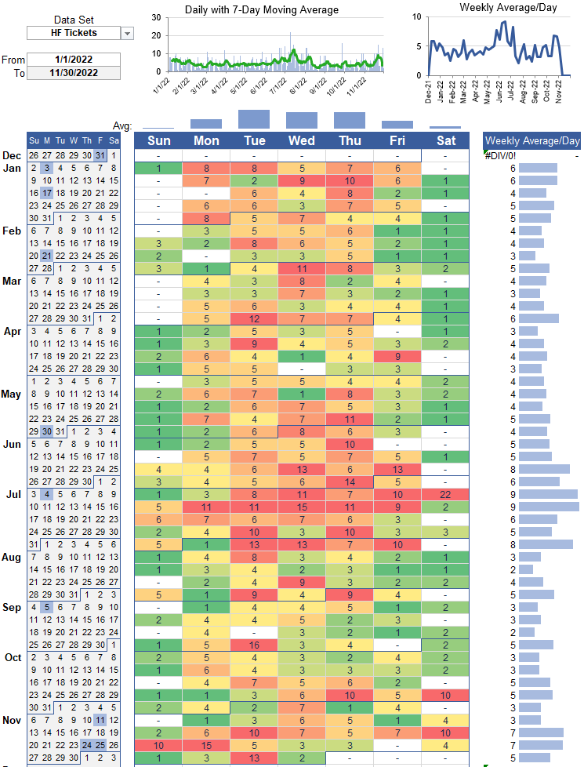
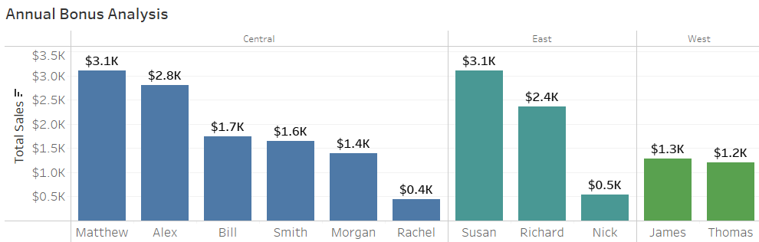
Report Visualizations
Line chart showing results over time
Calendar heat map showing daily case volume, company holidays, daily & weekly averages.
Bar chart showing categorical data comparison

Slide 5
Dashboard Portfolio
A sample of dashboards I have created in:
Excel
Power BI
Tableau
Note: These dashboards were all built with public datasets. I can do rapid turnaround on a dashboard, and can usually produce a working model with multiple report pages in just a day or two.

Slide 6
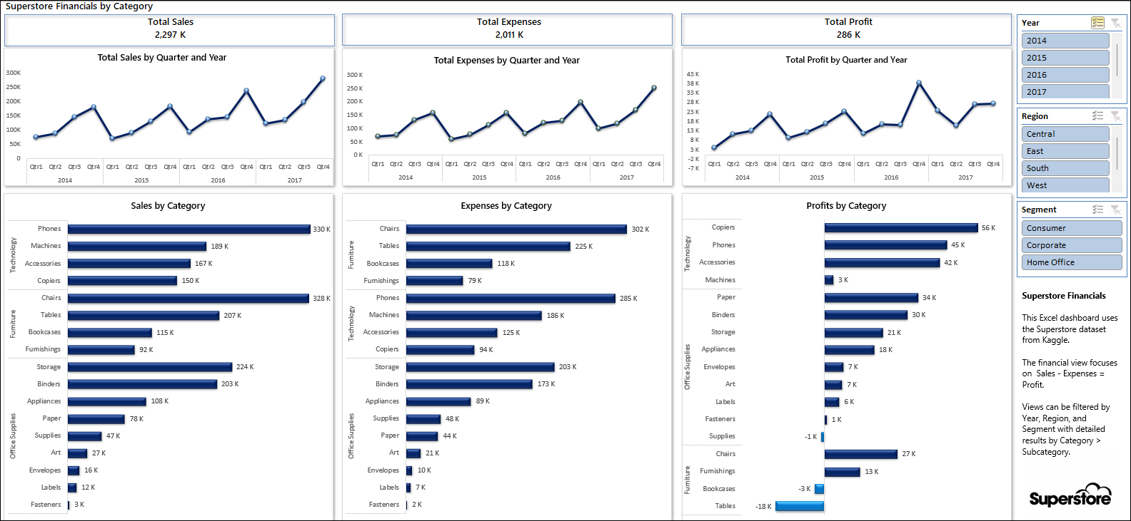
Excel: Superstore Financials
Note: Modeling based on Category / Subcategory shows the most and least profitable products.

Slide 7
Power BI Portfolio

Slide 8
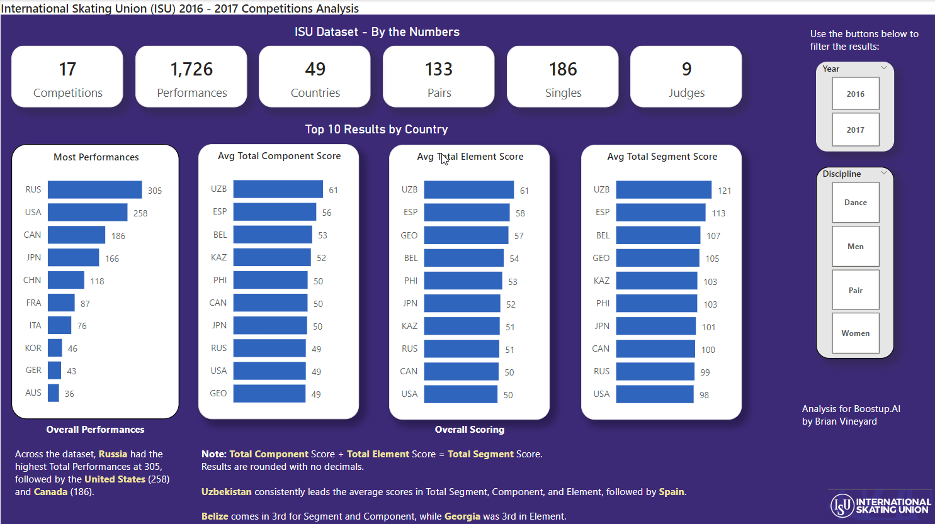
International Skating Union (ISU) Ice Skating Competition Analysis
Dataset: ISU Skating Competition Analysis from BuzzFeed News with data from Oct 2016 – Dec 2017

Slide 9
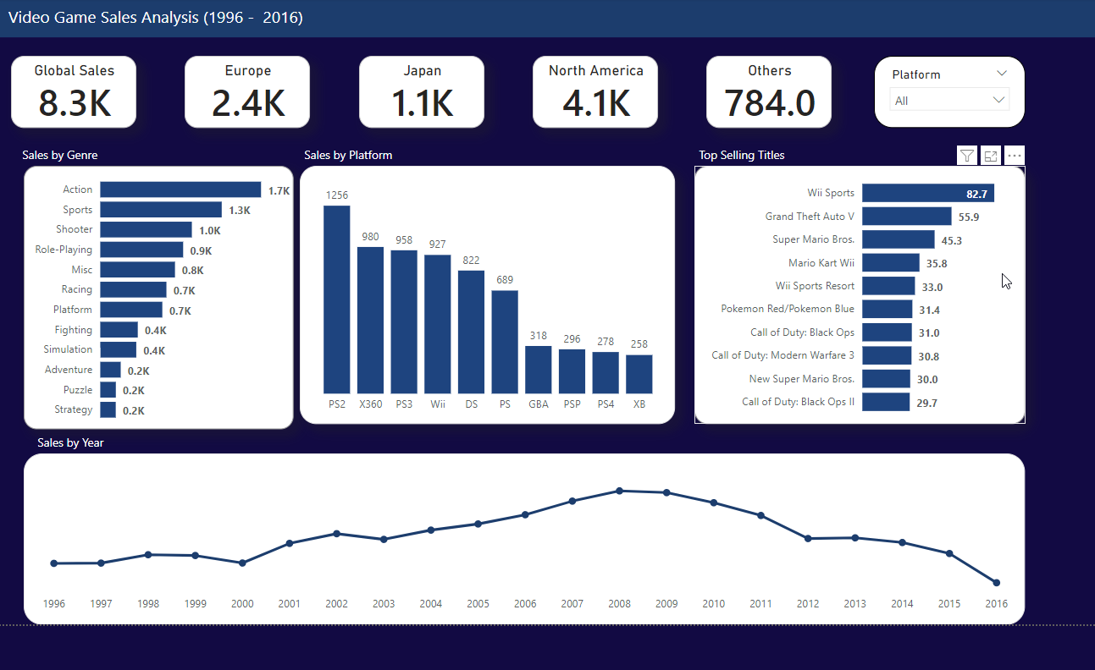
Video Game Sales Analysis
Dataset: Video game sales dataset from Kaggle with over 16,500 records of sales data over 20 years.

Slide 10
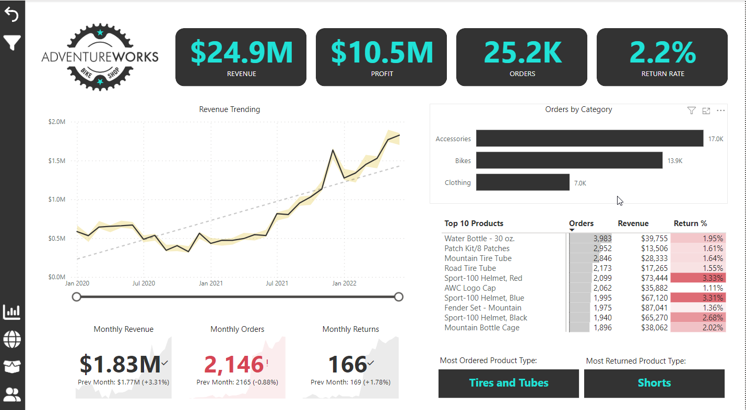
Adventure Works Financials Report

Slide 11
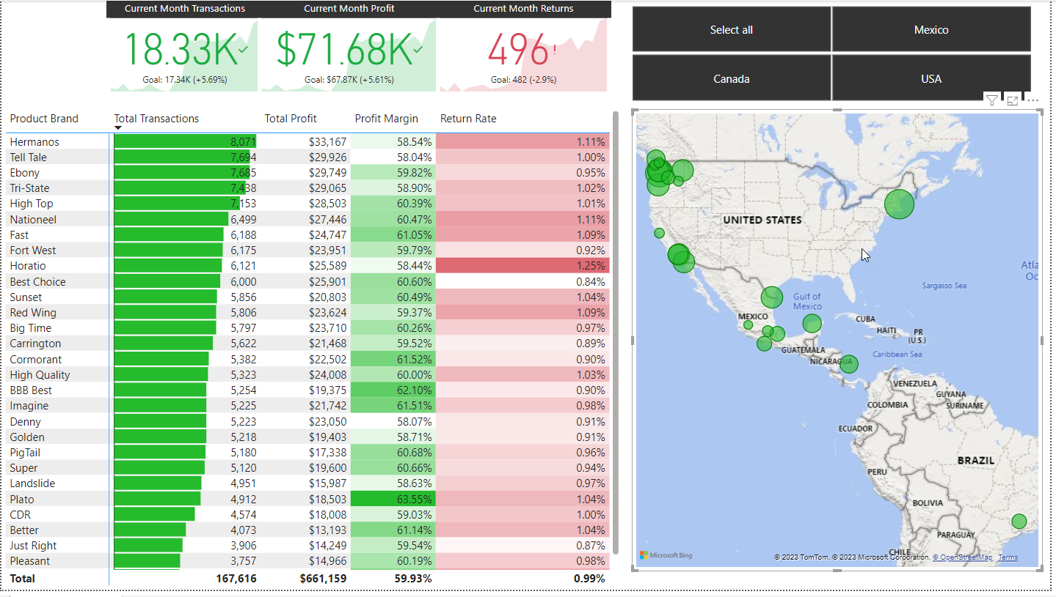
Power BI: Maven Market Financial Report

Slide 12
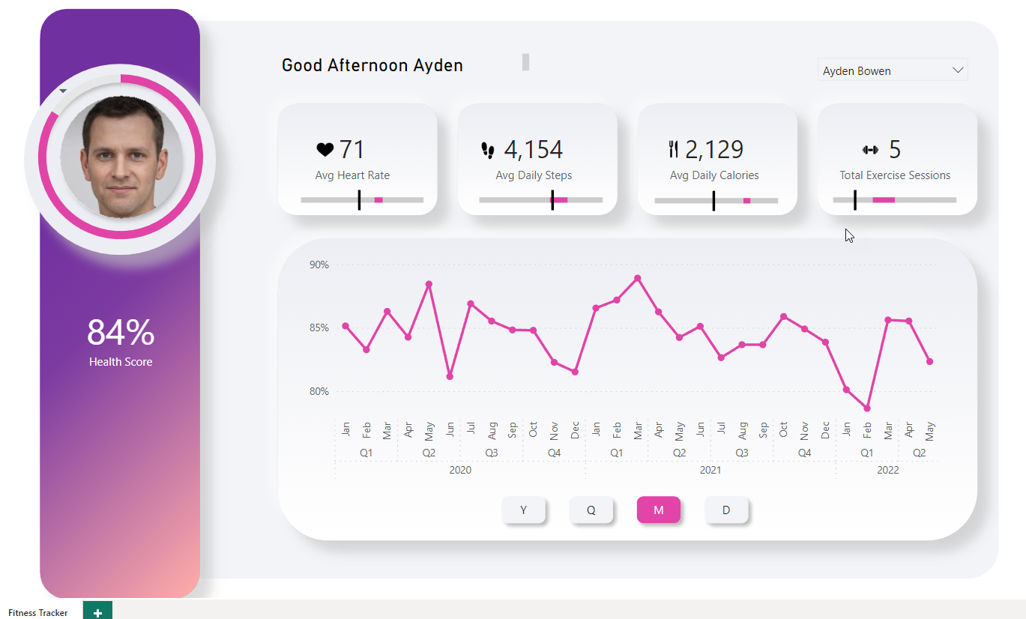
Power BI: Fitness Tracker App – for mobile use
Designed to look
like iOS mobile apps
DAX custom greeting based on time of day
Slicers to view results by day, month, year and quarter.
Minimal colors
Uncluttered design
Health Score over time showing results by year, quarter, month and day

Slide 13
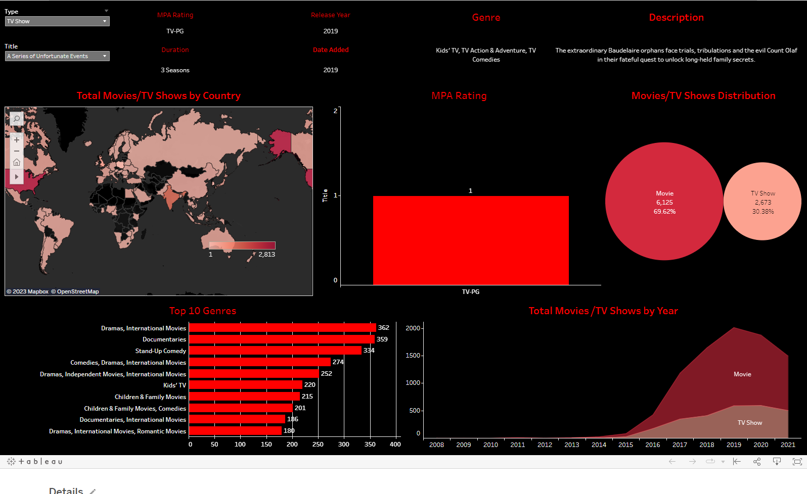
Tableau: Netflix Data
This dashboard is
available on Tableau
Public at https://public.tableau.com/app/profile/brian.vineyard/viz/netflix_16879639661060/Netflix.
Users can see Netflix
Movies and TV Shows
and select countries
using the world map to
see the most popular results in that region.

